Slide 1

Study Guide
Introduction to Natural Resources Management
GENS/GENV 2101
Larry A. Swatuk, Phd
Instructor

Slide 2
Class 1

Slide 3
Where to begin?
What is an EIA?
‘A process or set of activities designed to contribute pertinent environmental information to project or program decision-making’ (Beanlands & Duinker, 1983: 18).
A process for ‘determining and managing (identifying, describing, measuring, predicting, interpreting, integrating, communicating, involving, controlling) the potential (and real) impacts (direct and indirect, individual and cumulative, likelihood of occurrence) of proposed (or existing) human actions (projects, plans, legislation, activities) and their alternatives on the environment (physical, chemical, biological, ecological, human health, cultural, social, economic, built and their interrelations. (Lawrence, 2003: 7).

Slide 4
What are necessary steps?
What are the Government/Private Sector stated goals?
Profit
Sustainability
Community engagement & betterment
Establish a baseline (pre-process process: what is known)
Literature review
Scoping exercise
Stakeholder mapping
Risk analysis
Gap analysis
Develop a process

Slide 5
8 Criteria for Determining Best Practices for EIA (from Sinclair & Doelle, 2010: 64)
A strong legal foundation establishes EIA as a mandatory and enforceable process, and one that provides clarity, certainty, fairness, and consistency
A broad definition of the environment and related processes stipulates requirements to ensure EIA is applied to all environmentally significant undertakings.
The EIA process identifies the best options rather than merely acceptrable proposals, and requires critical examination of purposes and comparative evaluation of alternatives to the initiative as well as of alternative means to undertake the proposal.

Slide 6
EIA best practice continued
The EIA process limits ministerial discretion
The EIA process is open and fair, provides a significant role for the public, and contains provisions for public notice, comment, access to information, and participant funding
The EIA process has enforceable terms and conditions for approval of an initiative
The EIA process explicitly addresses monitoring and other post-approval follow-up to ensure terms and conditions are met.
The EIA process ensures assessment work is connected to a larger context, including establishment of overall biophysical and socio-economic impacts.

Slide 7
Class 2
Parts 1 and 2

Slide 8

Stakeholders
“Persons or groups with a legal responsibility relative to a problem or issue, or likely to be affected by decisions or actions regarding the problem or issue, or able to pose an obstacle to a solution of the problem or issue”.

Slide 9
Key Definitions
Nature refers to the totality of phenomena that are not created by humans, often understood as the non-human world governed by physical, biological, and ecological processes.
The natural world is the observable, material manifestation of nature—the ecosystems, species, landscapes, and physical processes that exist independently of human construction.
The biosphere is the global, integrated system of all living organisms and the zones of Earth that support life.
The environment refers to the surrounding conditions—natural, built, social, and institutional—that affect organisms or societies.

Slide 10
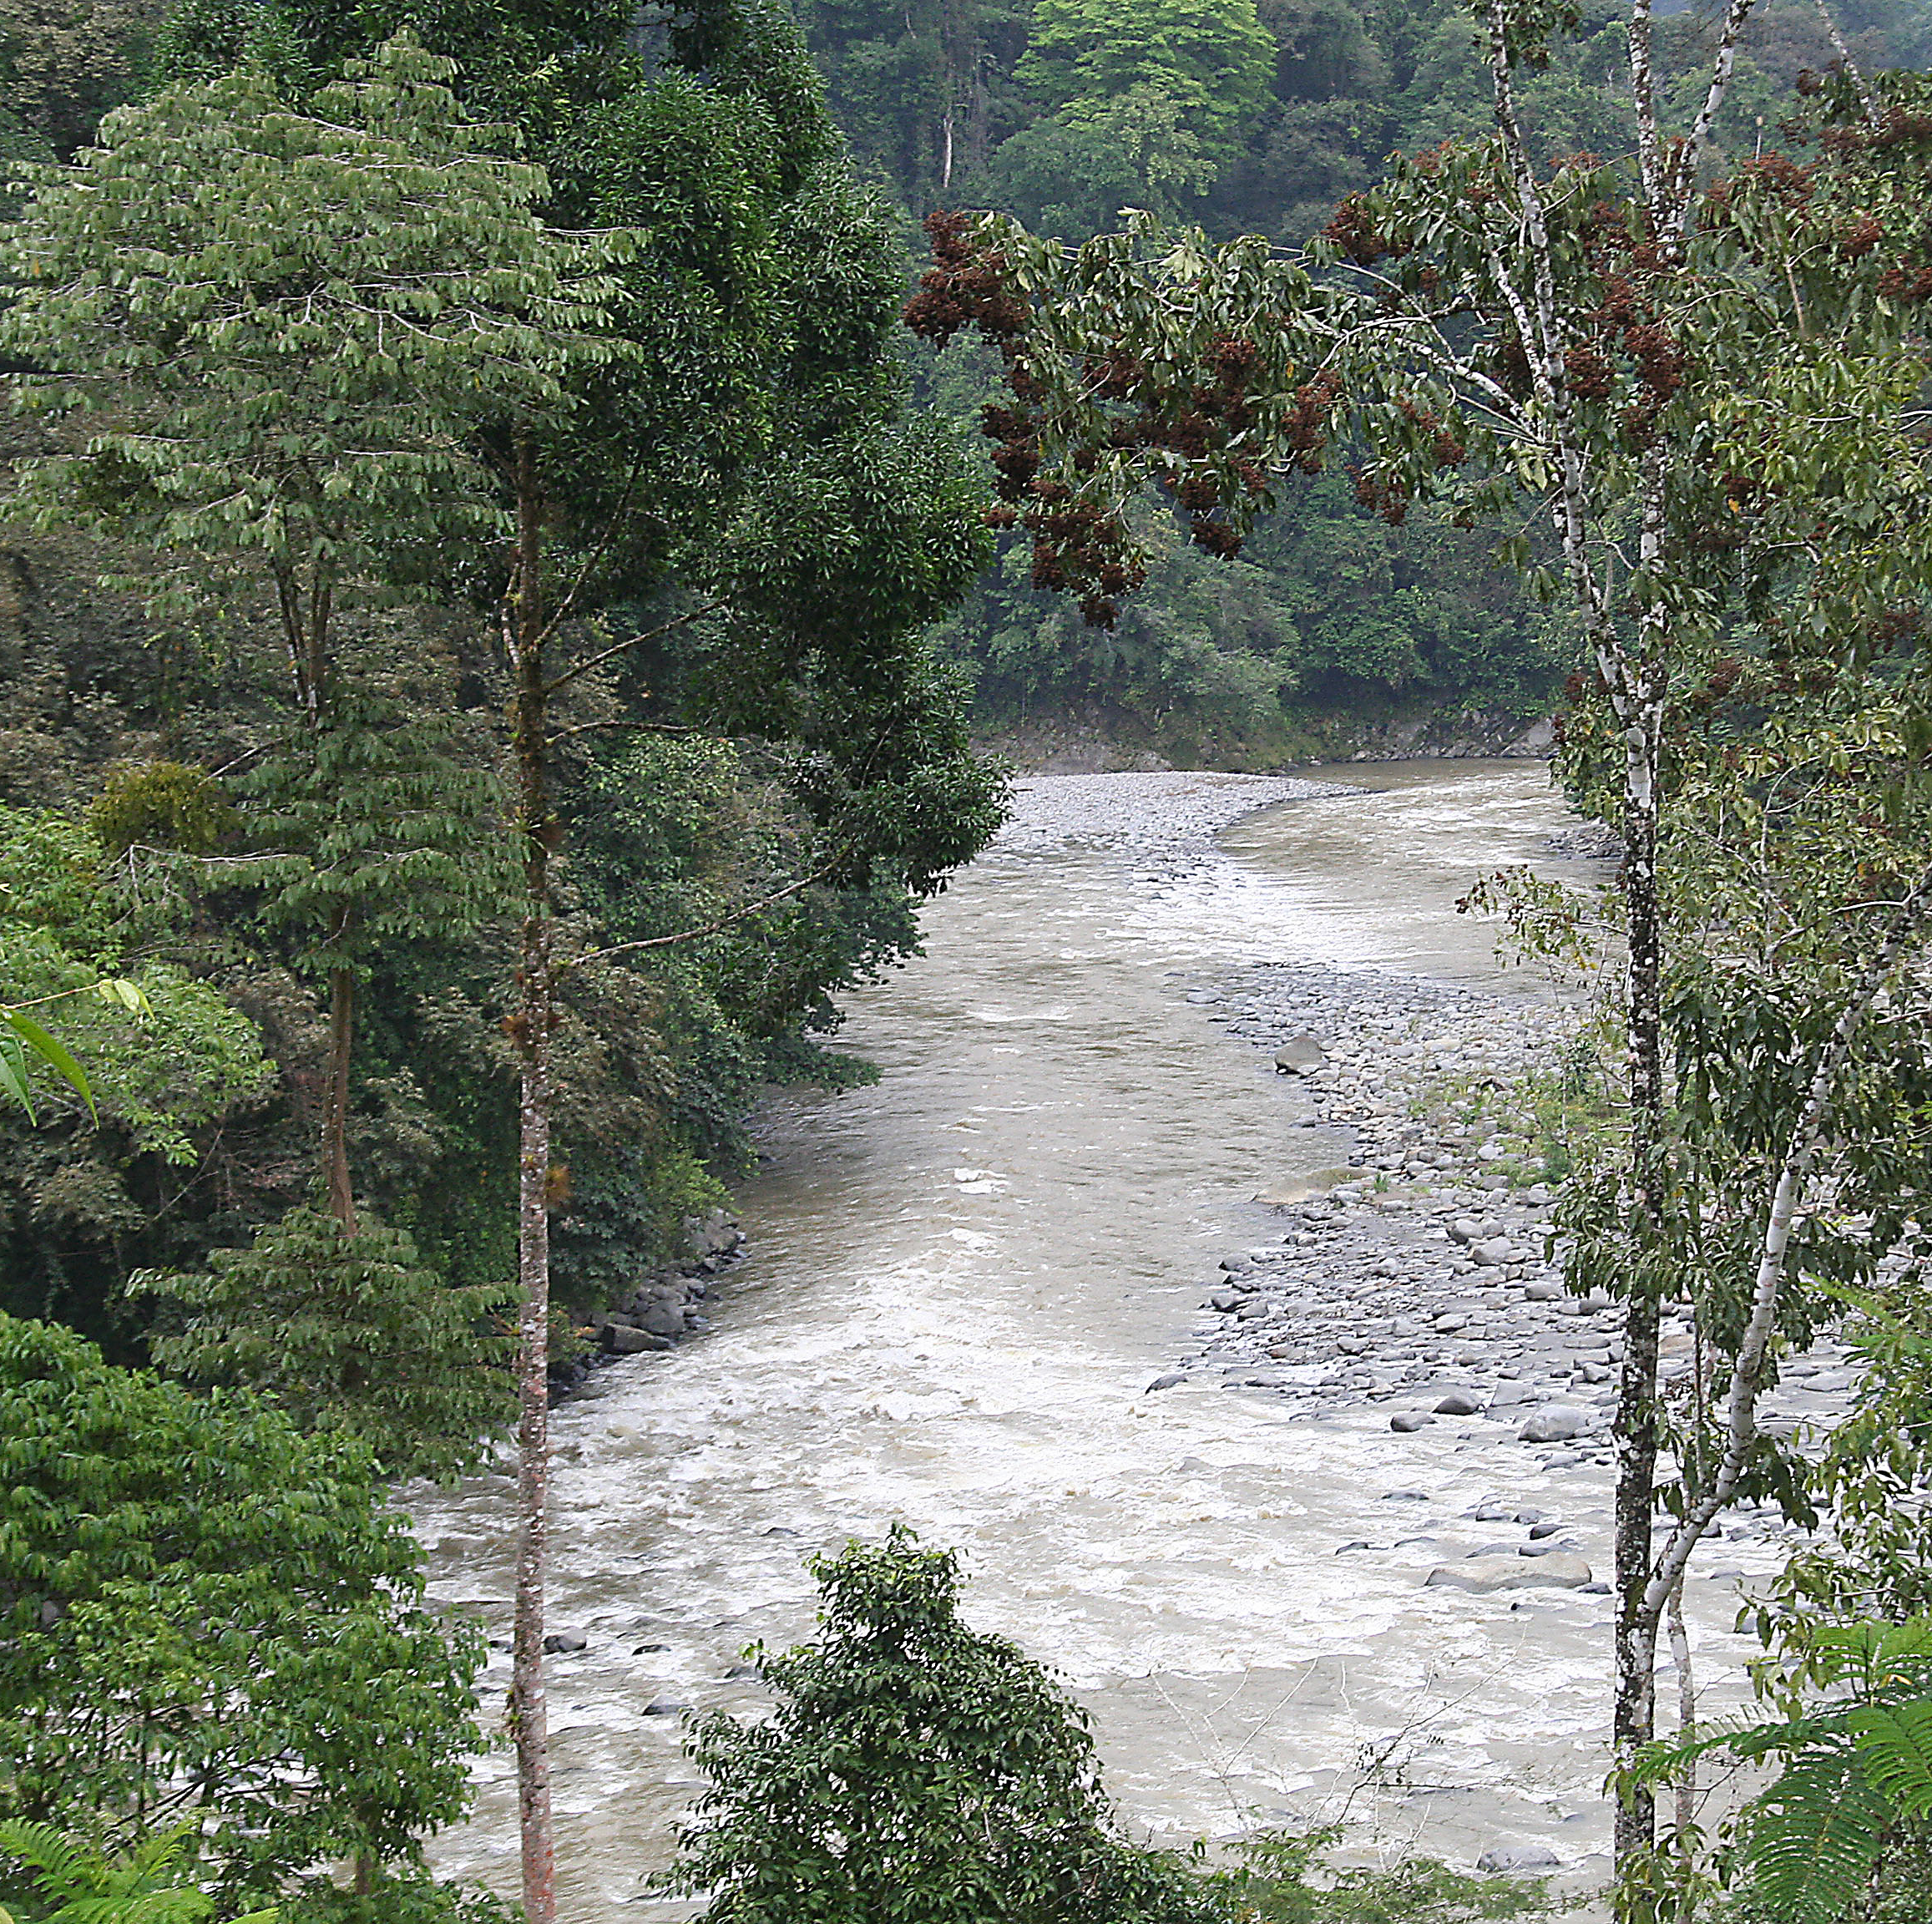
Different Perspectives
Ecocentric (system-centred value system)
Natural resources are interdependent components of ecological systems—living and non-living—that together sustain the integrity, resilience, and functioning of the Earth’s life-support systems, of which humans are a part.

Slide 11
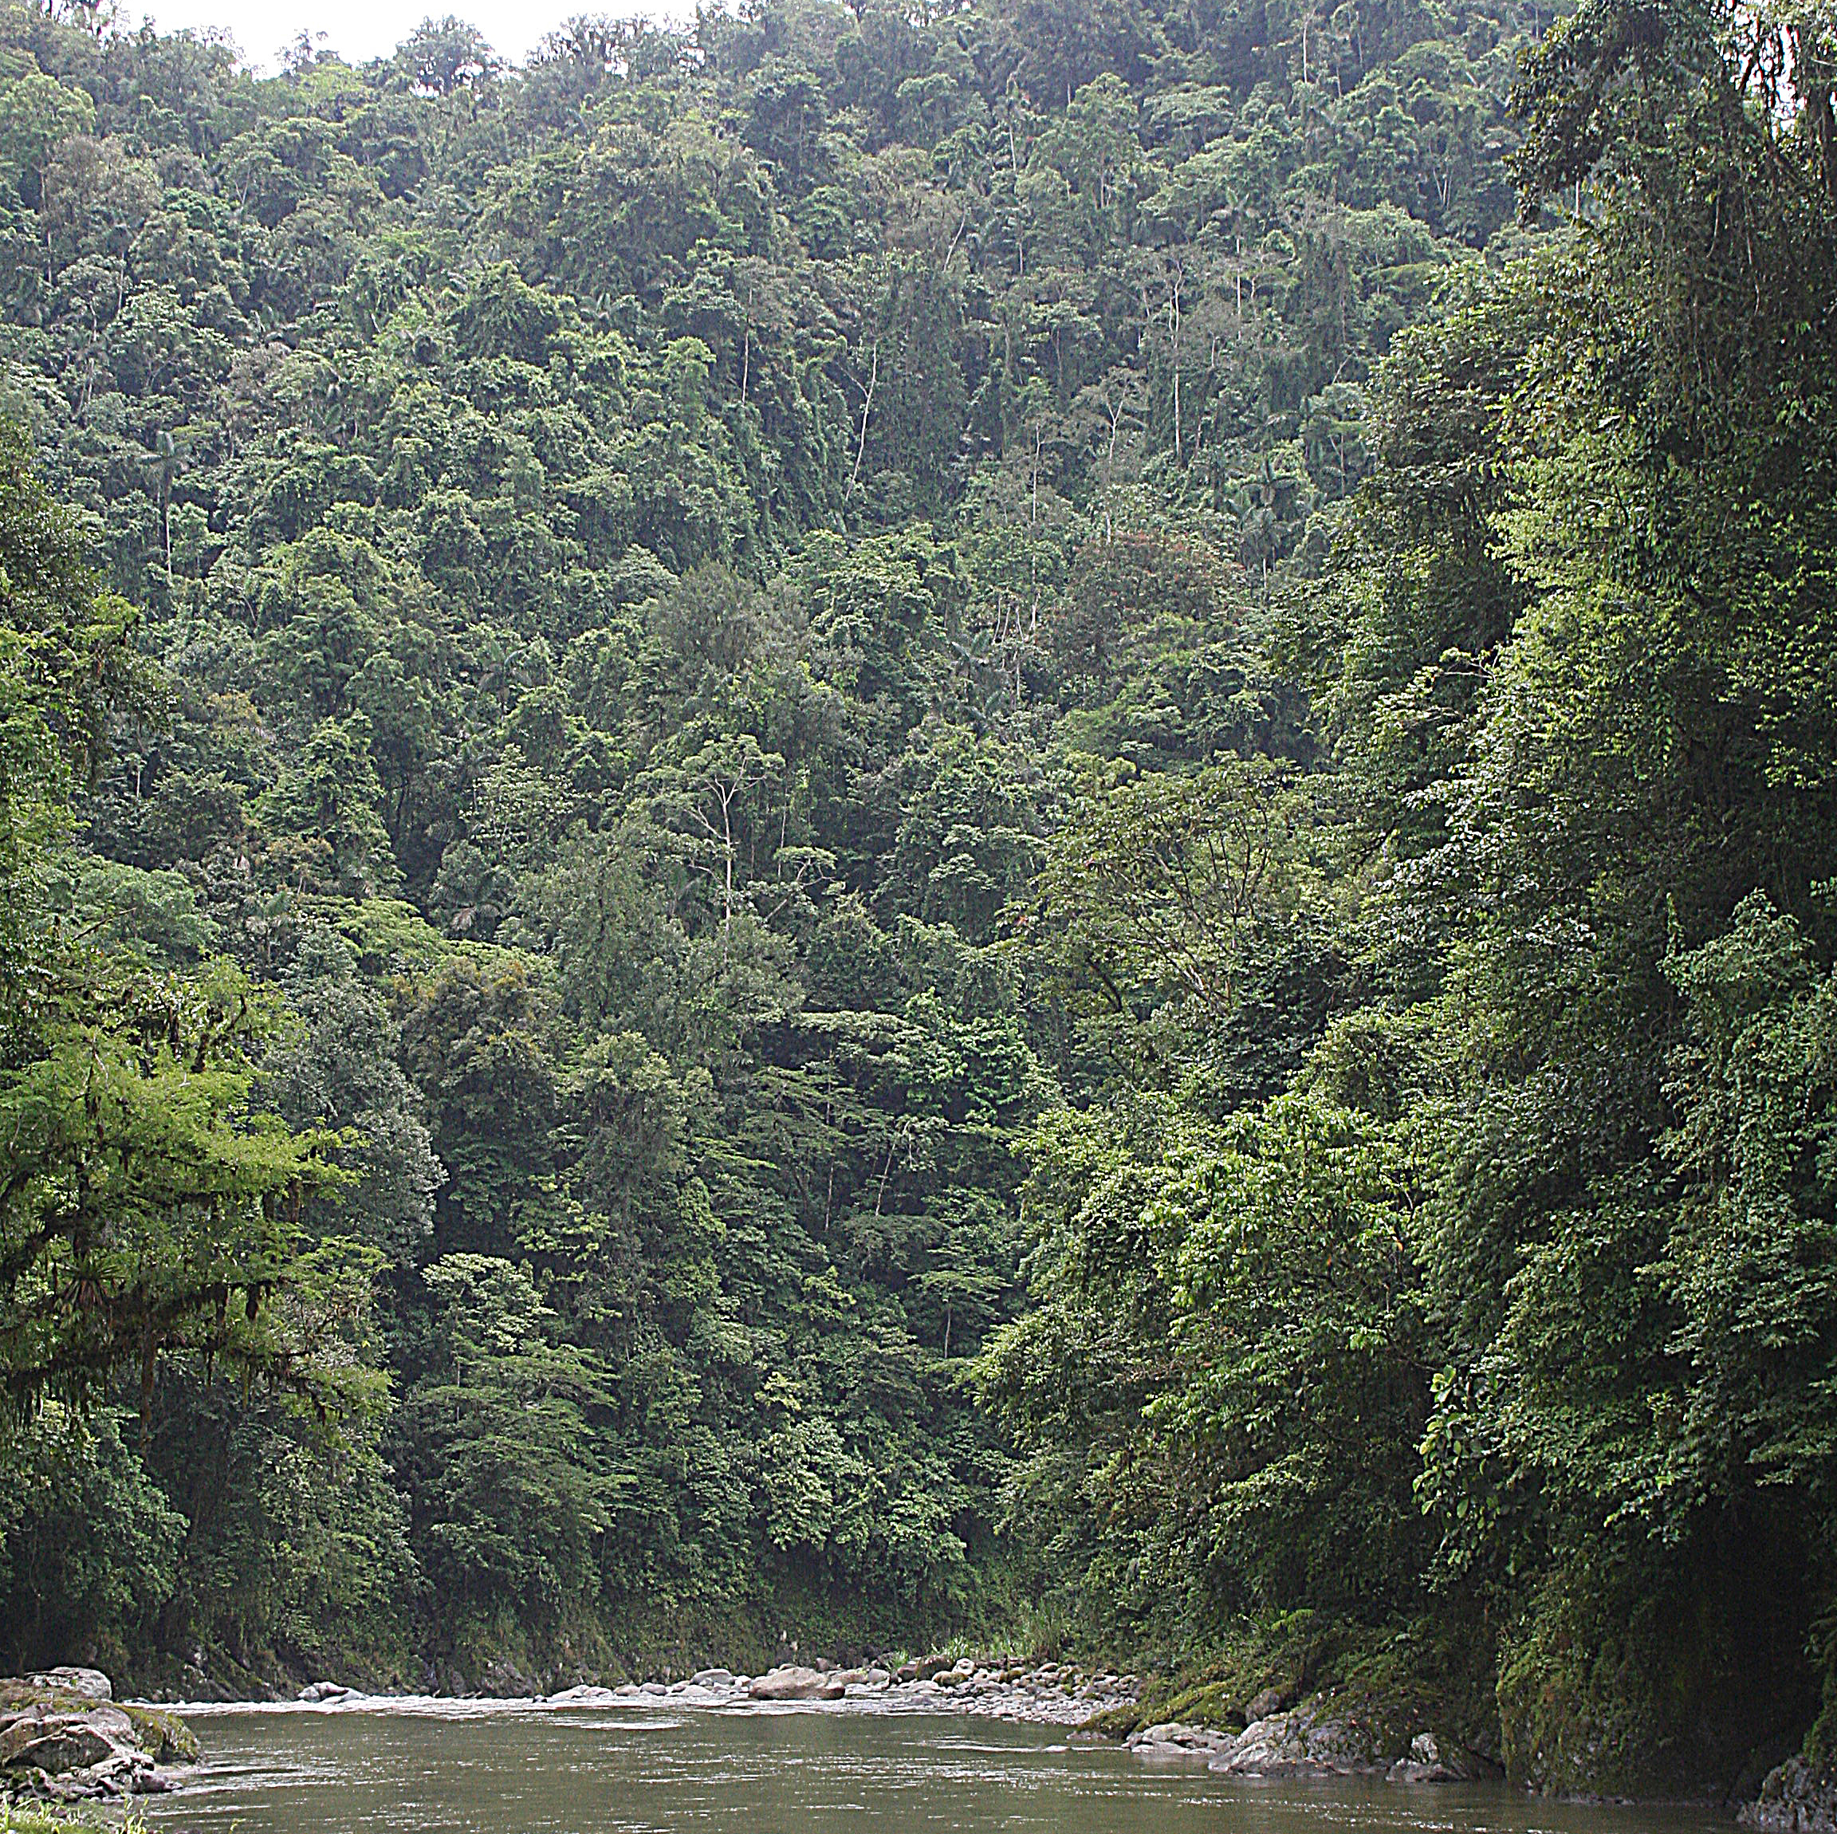
Different Perspectives
Biocentric (life-centred value system)
Natural resources are living organisms and ecological processes that sustain life, each possessing intrinsic value independent of human use, with humans regarded as one species among many.

Slide 12
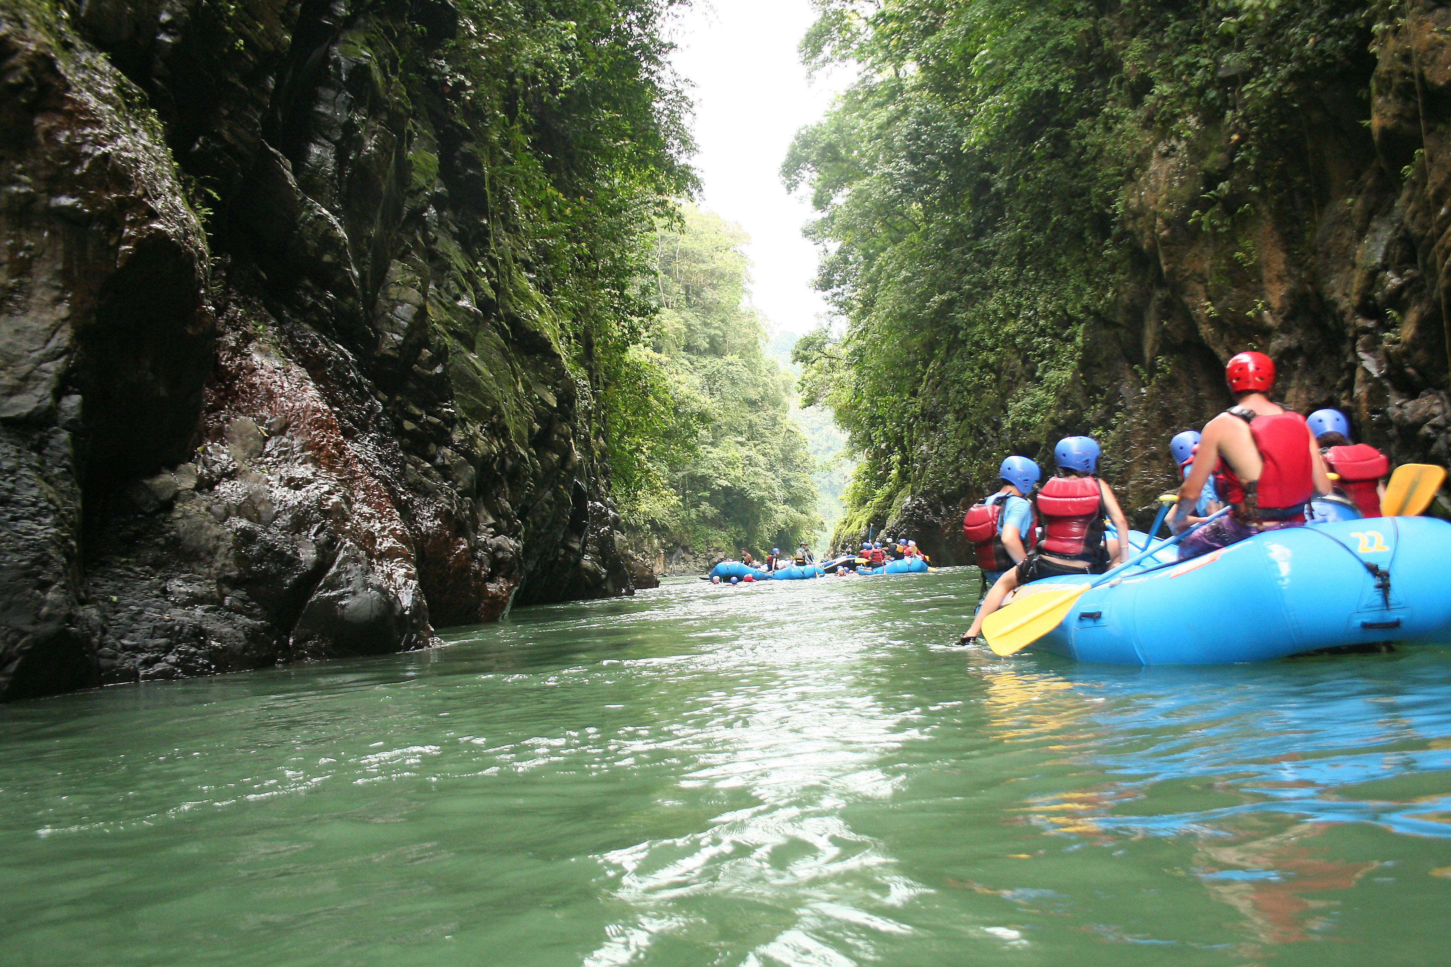
Different Perspectives
Anthropocentic (human-centred value system)
Natural resources are components of the natural environment that humans value, appropriate, or manage for human needs and purposes, including economic production, livelihoods, security, and well-being.

Slide 13
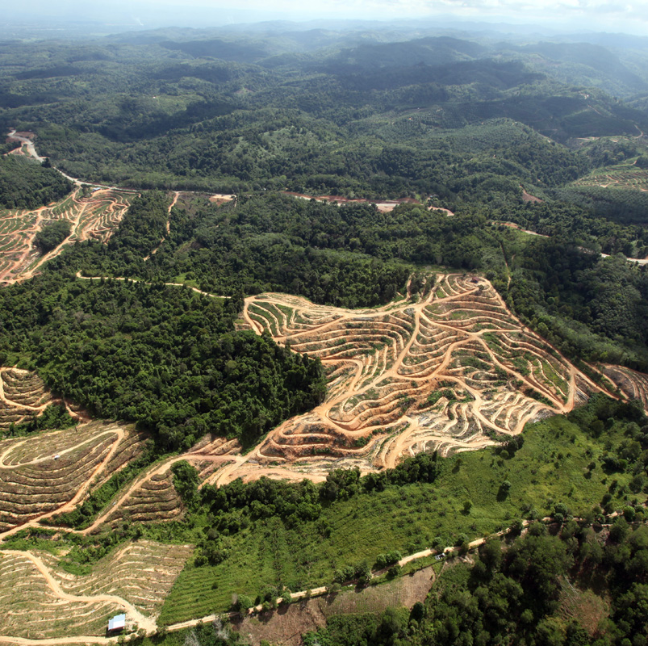
Crucial Insight for NRM
In real-world natural resource management, policies often blend these perspectives:
Anthropocentric logic dominates law, economics, and permitting
Biocentric values surface in species-at-risk and animal welfare
Ecocentric thinking underpins ecosystem-based management, watershed planning, and resilience frameworks

Slide 14
Class 3

Slide 15
Stakeholder Mapping
Stakeholder mapping is the systematic identification, characterization, and analysis of all actors who affect, are affected by, or have authority, knowledge, or interests related to natural resource management decisions, in order to design legitimate, effective, and durable policy and planning processes.
In natural resource management, stakeholder mapping is foundational because resources are:
Shared across space and time
Governed by multiple authorities
Embedded in social, cultural, ecological, and economic systems
Sites of power, inequality, and conflict

Slide 16

Remote Area Dweller
Urban Shack Dweller
Ordinary citizen?
Civil Society
National, International
Private Sector
IFIs
Central State
Donor States
INGOs

Slide 17
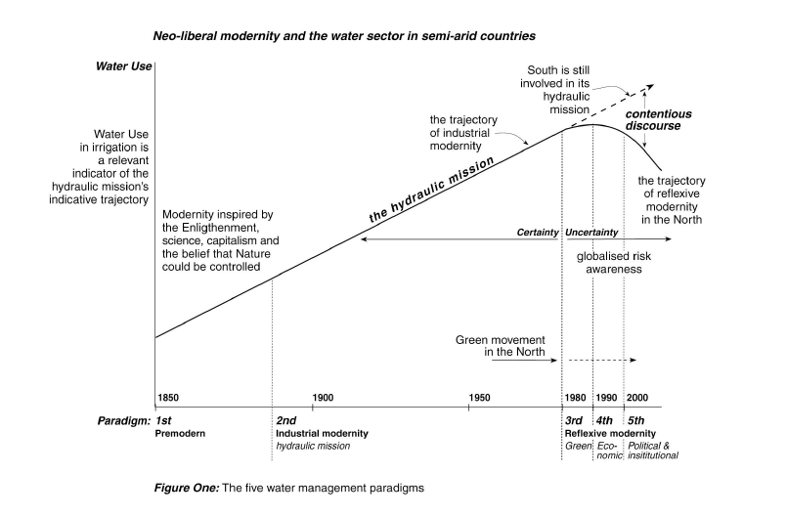

Slide 18
Class 4

Slide 19
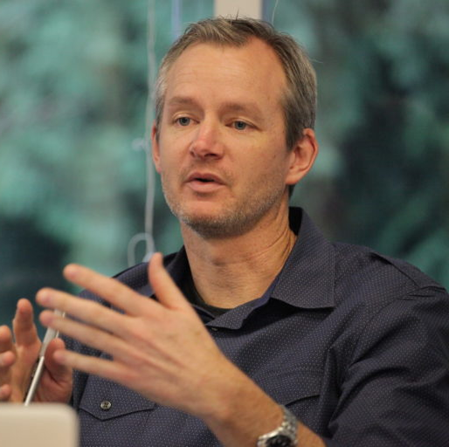
What is ‘natural resources management’?
NRM “is an adaptive and collaborative process through which actors across scales manage social–ecological systems to sustain ecosystem functions, livelihoods, and resilience in the face of change”
Derek Armitage (2009)

Slide 20
Government of Canada Definition
Natural resource management is ”the sustainable development, conservation, and wise use of Canada's natural resources (land, water, minerals, forests, wildlife) for current and future generations, balancing economic prosperity with environmental protection through science, policy, regulation, and collaboration to ensure long-term benefits and competitiveness.”
“Committed to improving the quality of life of Canadians by ensuring the country’s abundant natural resources are developed sustainably, competitively and inclusively”. (NRCAN homepage: https://natural-resources.canada.ca/)

Slide 21

Sustainable Development
The Brundtland Report Our Common Future (1987), defines sustainable development as "development that meets the needs of the present without compromising the ability of future generations to meet their own needs.”
[https://sdgs.un.org/goals]

Slide 22
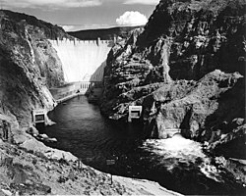
High Modern Definition of NRM?
Hoover Dam, 1936

Slide 23

Ken Conca, Governing Water
The ‘ought’
T: The river basin
A: All affected stakeholders
K: All relevant forms of knowledge (including TEK, IK, ‘local’)
The ‘is’
T: The sovereign state
A: The government (and partners)
K: The ‘expert’ (technical and financial)
*TAK = Territory, Authority, Knowledge

Slide 24
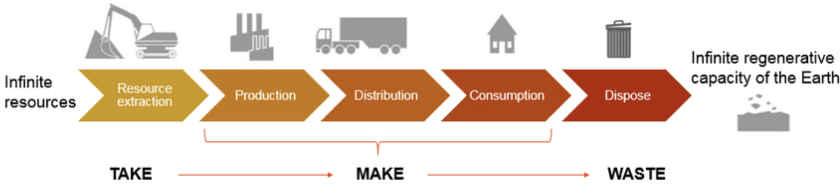
Traditional Resource Management System

Slide 25
Traditional resource management
Reached its apex in the “high-modern industrial” age (Allan’s Paradigm 3)
Humans manage nature
The ‘system’ is linear and predictable (”uncertainty” is minimized or ignored)
The primary focus is to maximize resource yield and efficiency
The knowledge base is technical and expert-driven
Governance is centralized, sectoral
Characterized by top-down decisions with a “command and control” approach

Slide 26
Class 5

Slide 27
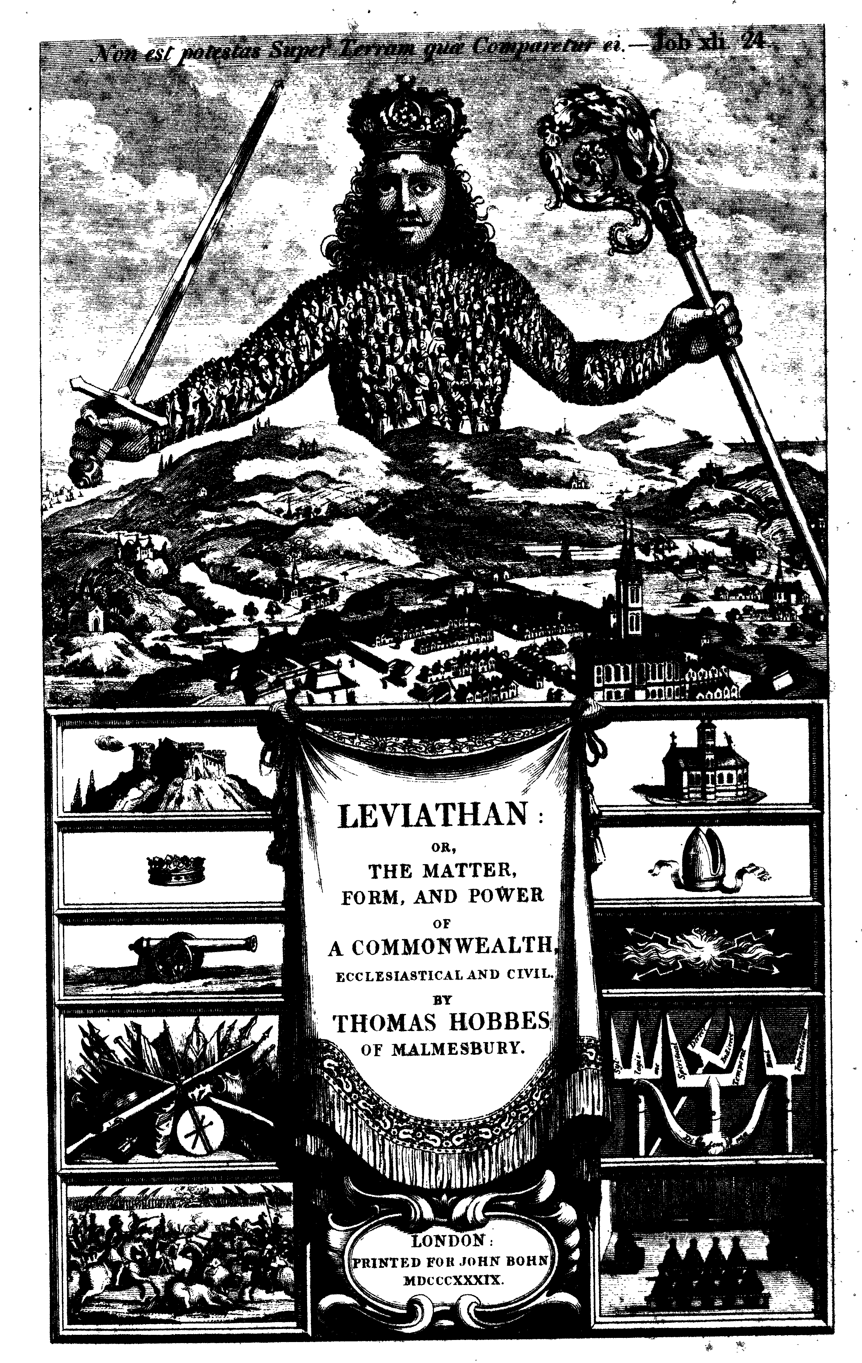
Governance in relation to Management
Governance defines the rules and authority for decision-making, while management implements those decisions and provides feedback that enables governance to adapt over time.
“Governance decides, management delivers”

Slide 28
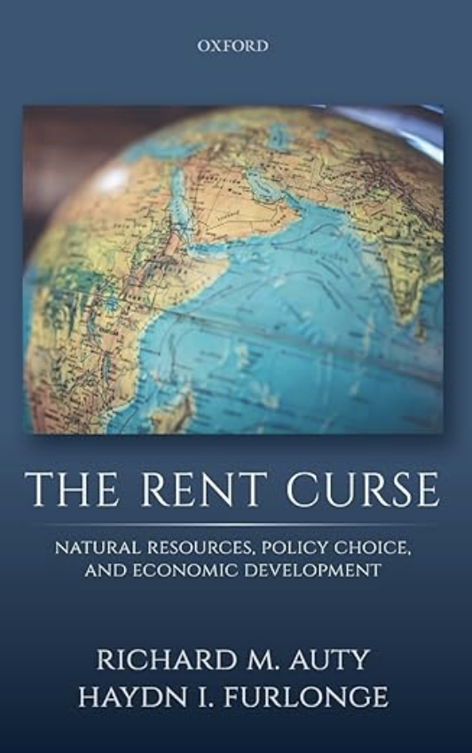
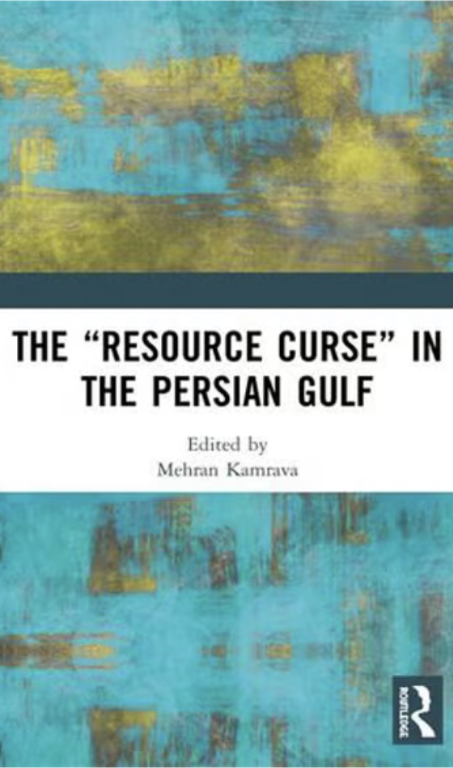
“Bad” Management & “Bad” Governance
Governance is centralized, sectoral
Characterized by top-down decisions
“command and control” approach

Slide 29
Interrelationship of Dominant Actors: aka the ‘social relations of production’
State (.gov)
Civil
Society
(.org)
Private
Sector
(.com)

Slide 30
Constellation of Social Forces: Who has power?
Point of Resource
Extraction
4
-Political and economic power
-Ideational power
-National and International
actors
3
2
1
-Direct beneficiaries
-Marginalized
-Excluded
Point of decision-
making
Idea initially developed by Canadian scholar, Robert Cox

Slide 31
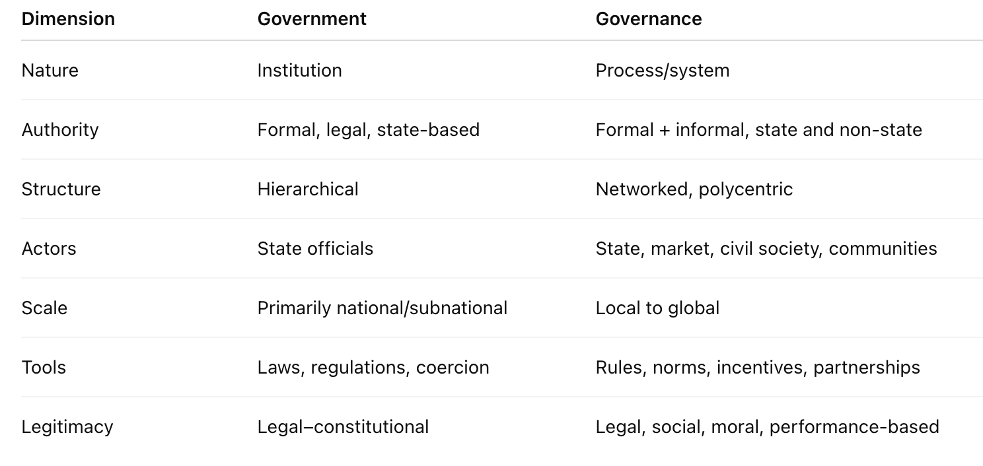

Slide 32
Class 6

Slide 33
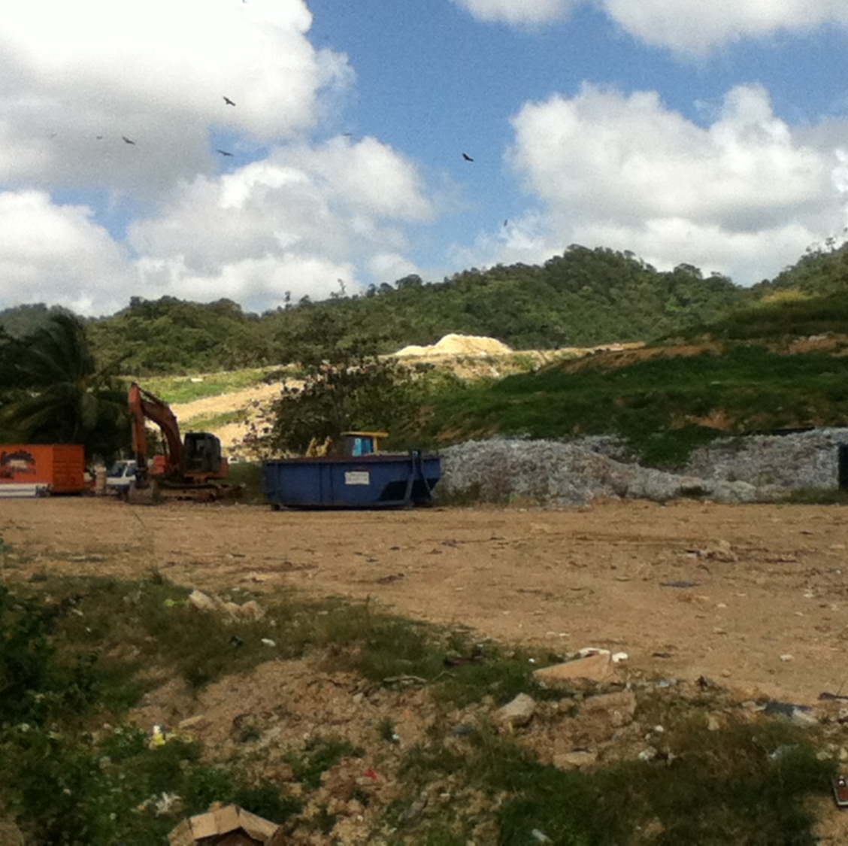
Governance
Governance is both outcome and process, involving a variety of legitimate and authoritative actors.
Good governance can never reach an end point; as a process it depends on the reiteration of activities that deepen trust
Notes:
As an outcome it reflects settled social relations. If it is good, it suggests widespread – if not universal – social approval of its practices. It is most readily constituted and observable at a local level, so raising questions about the fungibility of effective local governance, in particular the ways and means of moving from one socio-geopolitical scale to another.

Slide 36
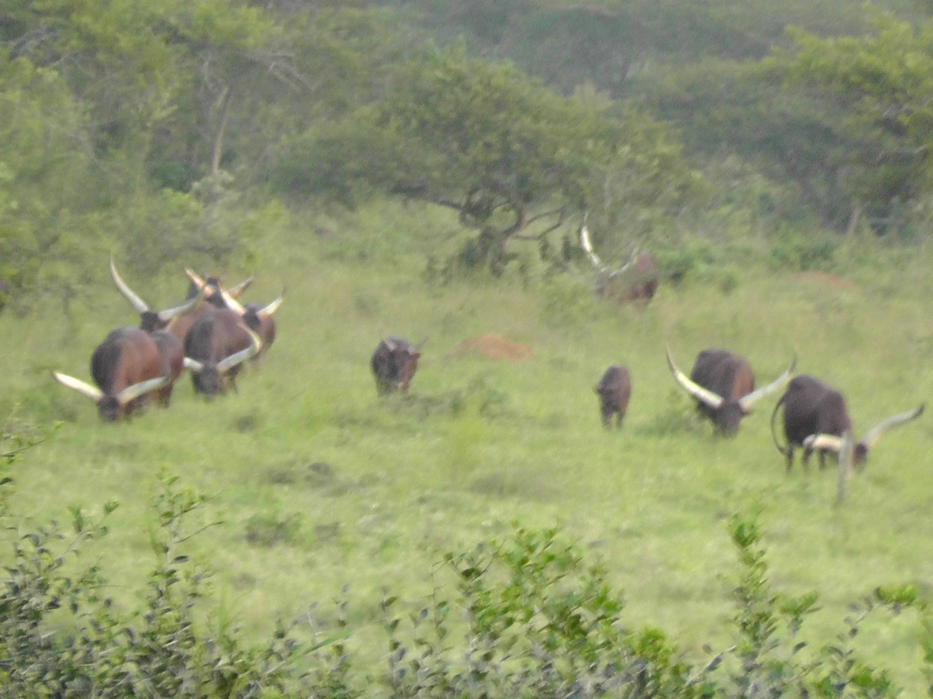
Beyond “Command and Control”
‘[I]t is often presumptuous to believe that humans “manage” environment and resources. More realistically, humans manage their interactions with environment and resources. For that reason, uncertainty (as a result of imperfect understanding), as well as ignorance, and conflict (as a result of many different and legitimate interests) are common. Furthermore, the complexity of biophysical and socio-economic systems is great, and is exacerbated by ongoing change, some of which is influenced or caused by human activity. Thus, to deveiop policies, programmes or plans for resource and environmental management, or to be able to appraise the effectiveness of initiatives, it is important to be able to recognize and deal with change, complexity, uncertainty and conflict.’
— Bruce Mitchell, 2002, Resource and Environmental Management, p. 346.

Slide 37
Class 7

Slide 38
Fundamental Challenge
Ecosystems are dynamic
But humans want order and predictability
Humans operate within the system but seek to dominate it
But action leads to reaction, often in unexpected ways
If we wish to remain within a particular system, we must recognize boundaries and acknowledge limits
Going beyond boundaries (a known order) will create a new system (an unknown or less well-known disorder)
Adaptation will be necessary (from Holocene to Anthropocene)

Slide 39
Energy Flow in an Ecosystem
Laws of thermodynamics describe the energy flow in an Ecosystem
1st Law (Law of Conservation of Energy): Energy can not be created or destroyed; it is merely changed from one form into another
2nd Law (Law of Entropy):When energy is transformed from one form into another, there is always a decrease in the quality of usable energy.

Slide 40
Why both laws matter for NRM
Law | What it tells us | NRM implication
First Law | Nothing disappears | Waste, pollution, and emissions are unavoidable
Second Law | Everything degrades | Efficiency, conservation, and prevention matter more than cleanup

Slide 41
From the Holocene to the Anthropocene
Holocene (≈ last 11,700 years)
Relatively stable climate
Energy flows dominated by:
Solar input
Biological processes
Human systems largely embedded within ecosystem limits
Anthropocene (≈ mid-20th century onward)
Rapid, large-scale human redirection of energy and materials
Fossil fuels unlock ancient stored energy
Human systems begin to override natural regulatory processes

Slide 42
Core concepts for socio-ecological systems approach
Sustainability
is not about stopping resource use—it’s about slowing down irreversible degradation.
Conservation
Conserving resources saves high-quality energy and materials for future use.
Circular economy (with limits)
Circular systems help—but thermodynamics tells us they can never be perfectly circular.
Ecosystem services
Ecosystems are energy-processing systems—once degraded, they require large energy inputs to restore (if restoration is even possible).

Slide 43
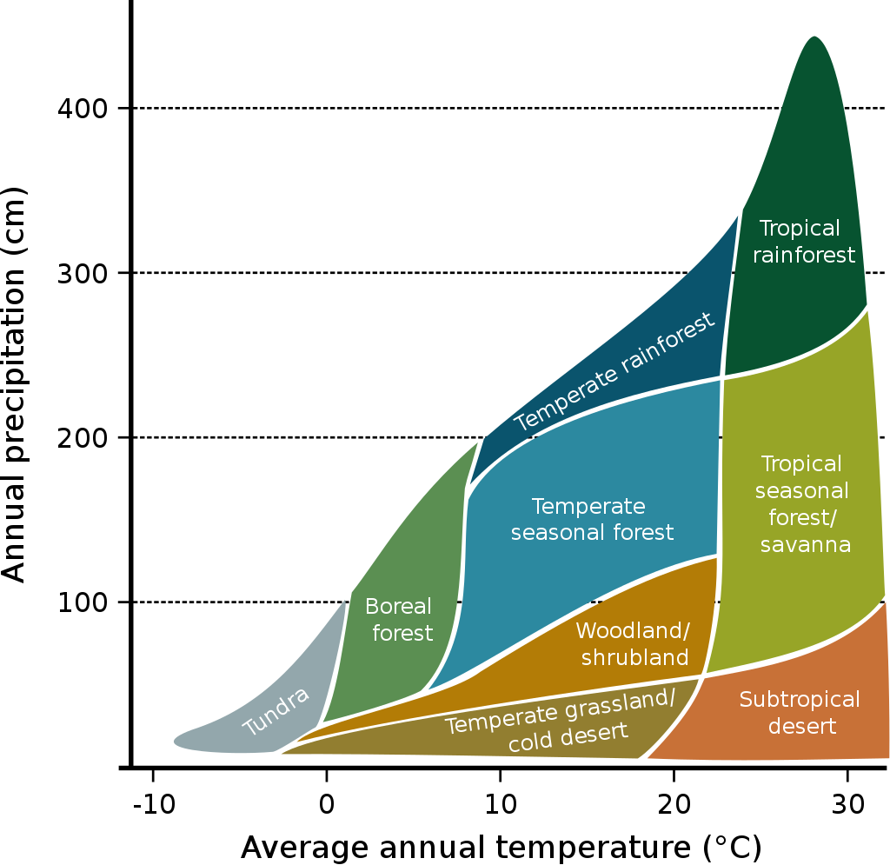
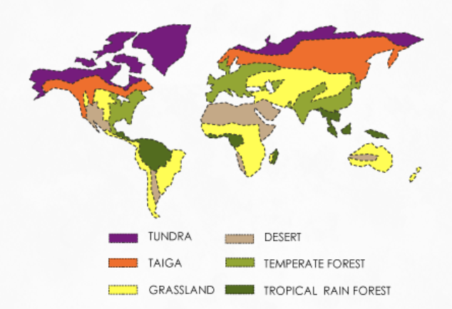
Major Biomes

Slide 44
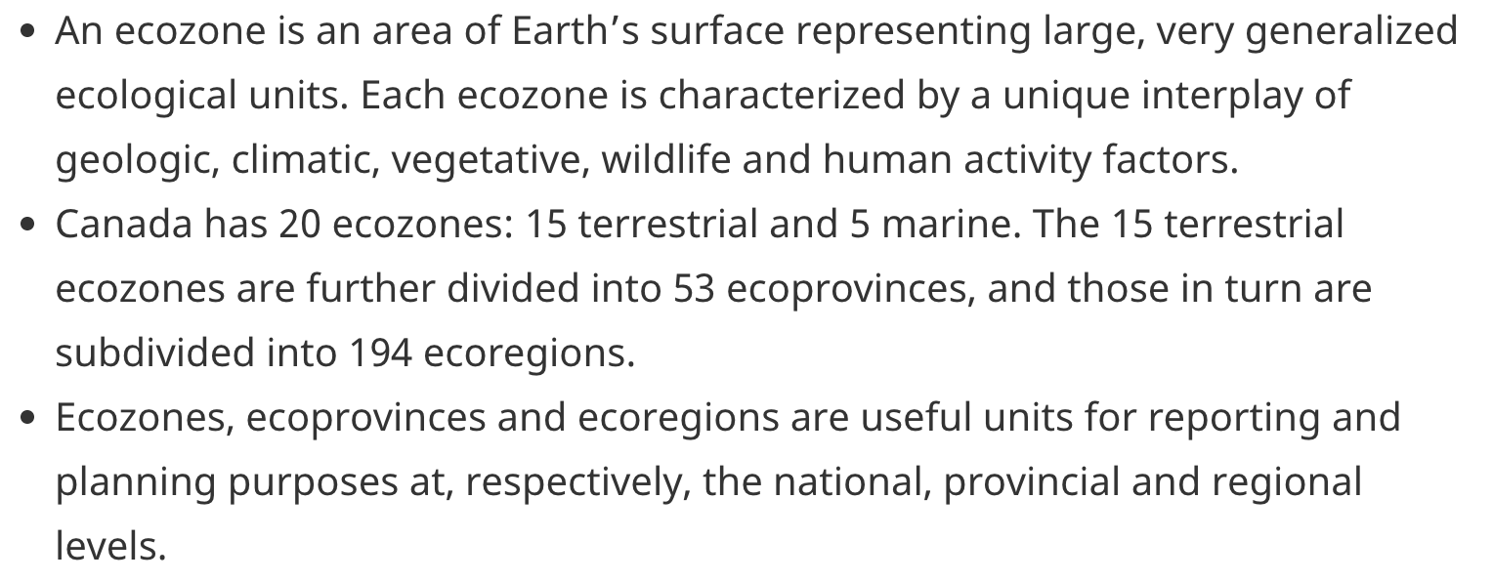
Ecozones

Slide 45
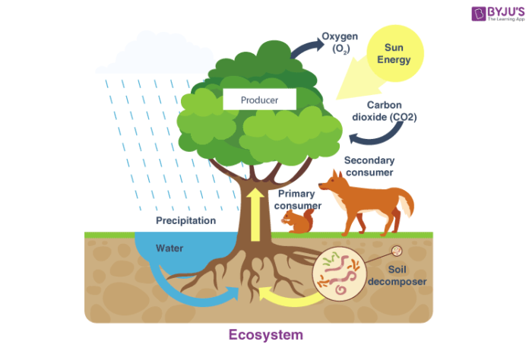
Ecosystem Based Management
Holistic management that takes into account the entire ecosystem and emphasizes biodiversity and ecosystem integrity, as opposed to focusing primarily or solely on a resource or resources, such as water or timber, within an ecosystem.

Slide 46
Class 8

Slide 47
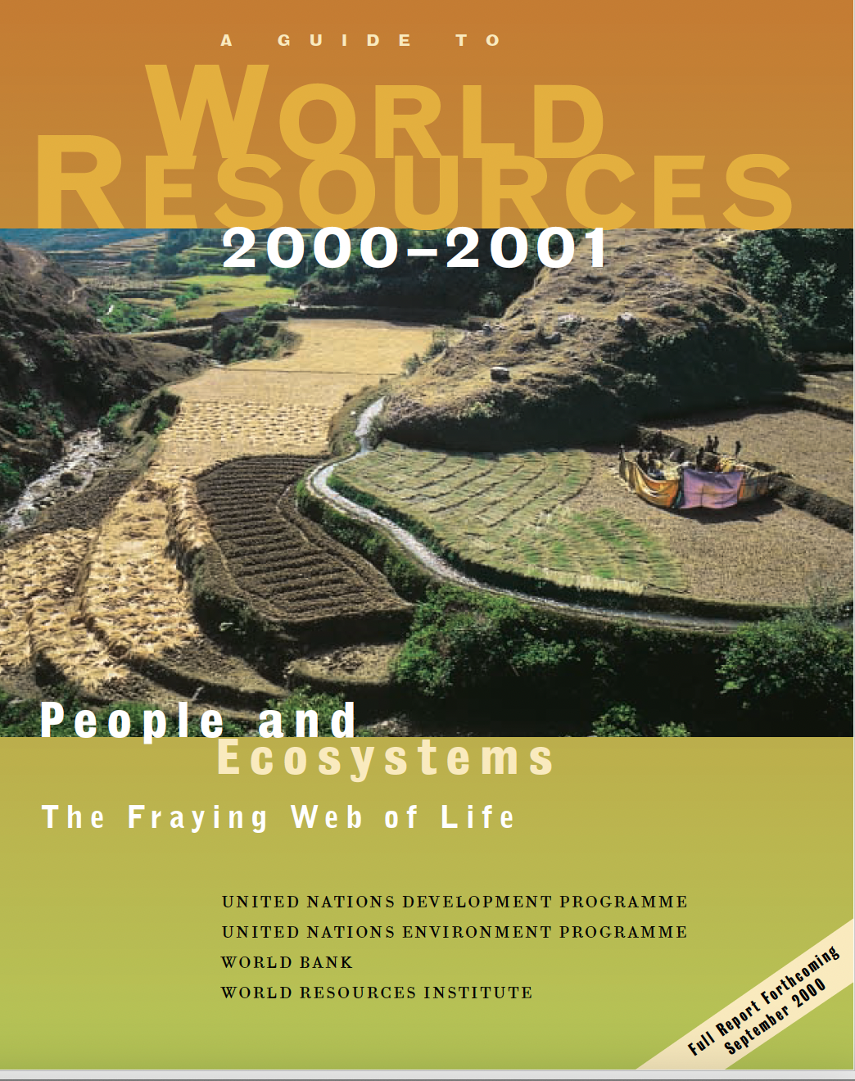
Ecosystem
A community of organisms occupying a given region within a biome, including the physical and chemical environment of that community and all the interactions among and between organisms and their environment

Slide 48
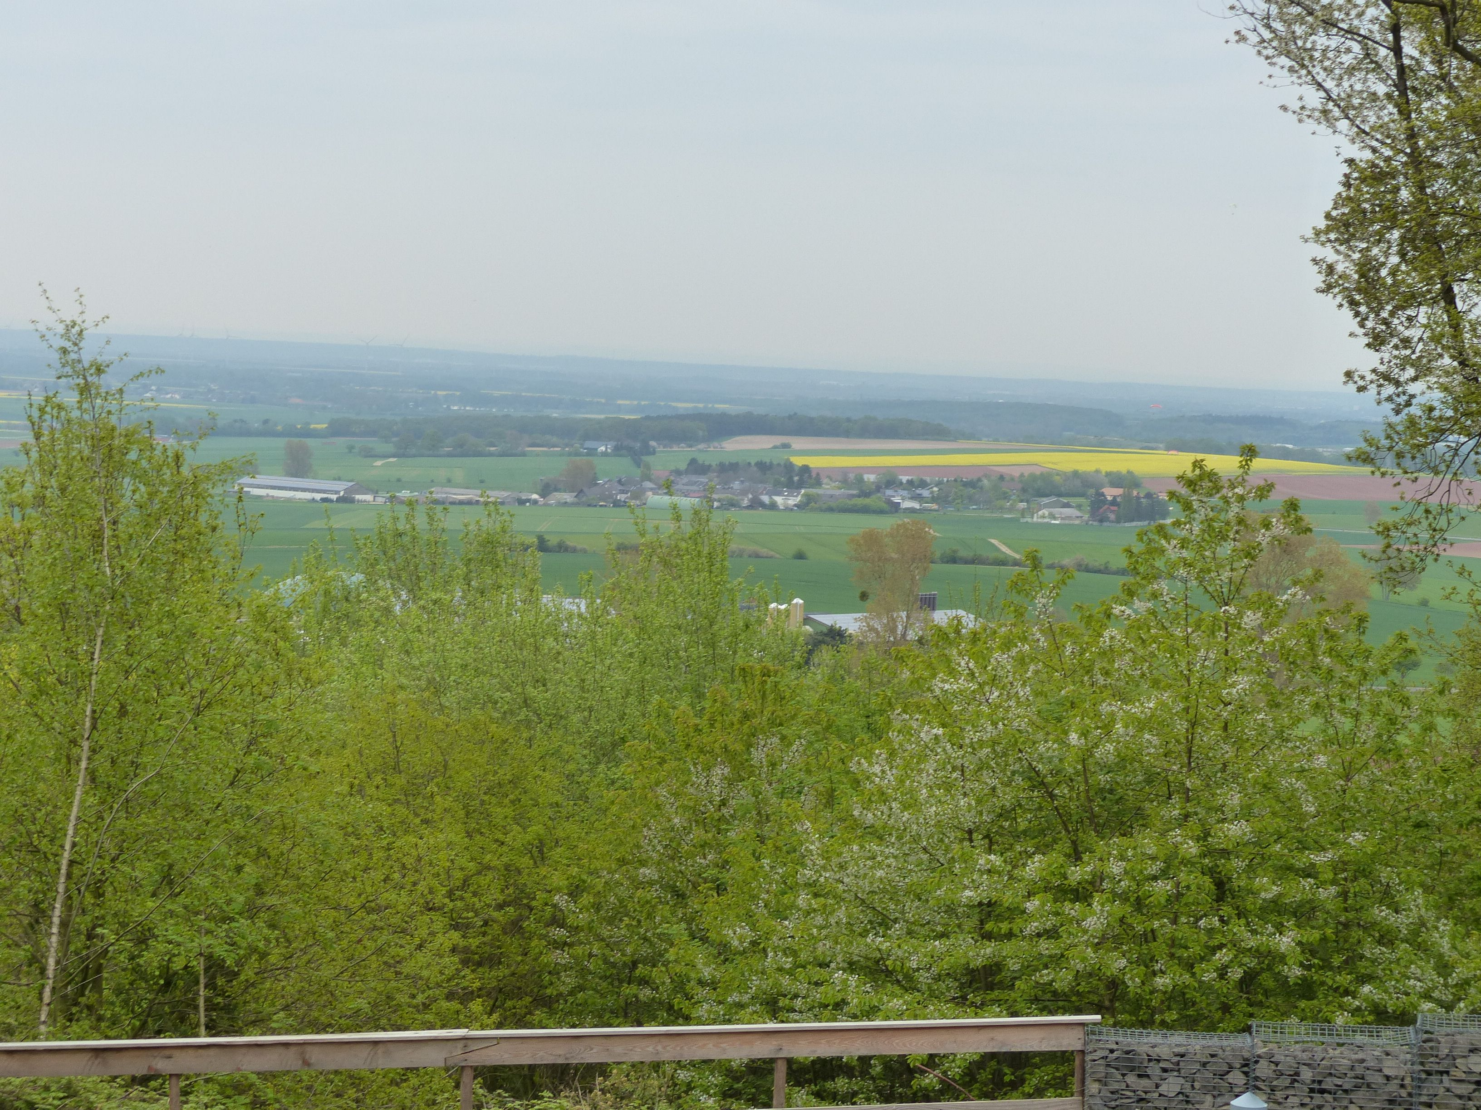
Ecosystems
Ecosystems sustain us. They are Earth’s primary producers, solar-powered factories that yield the most basic necessities – food, fiber, water.
Ecosystems also provide essential services – air and water purification, climate control, nutrient cycling, and soil production – services we can’t replace at any reasonable price.
-- World Resources 2000-01, p.8

Slide 49
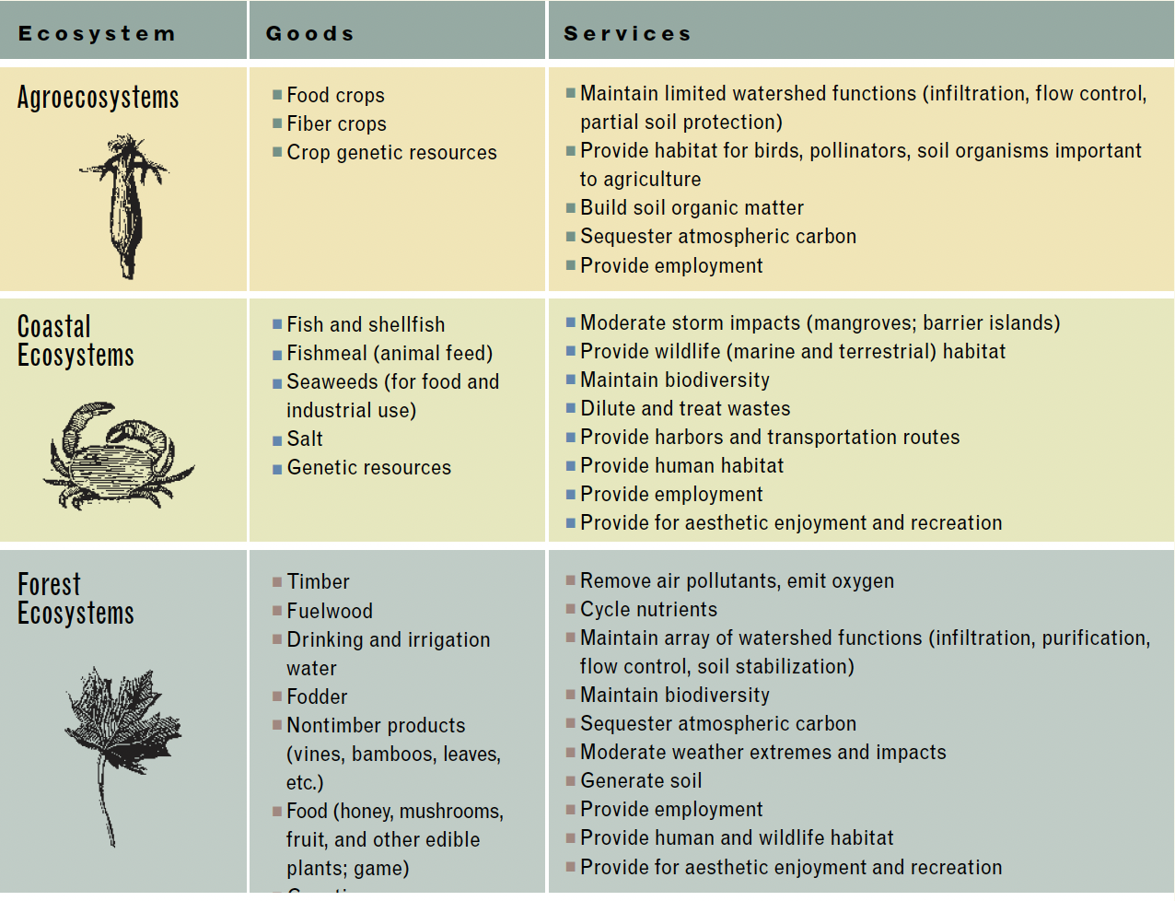

Slide 50
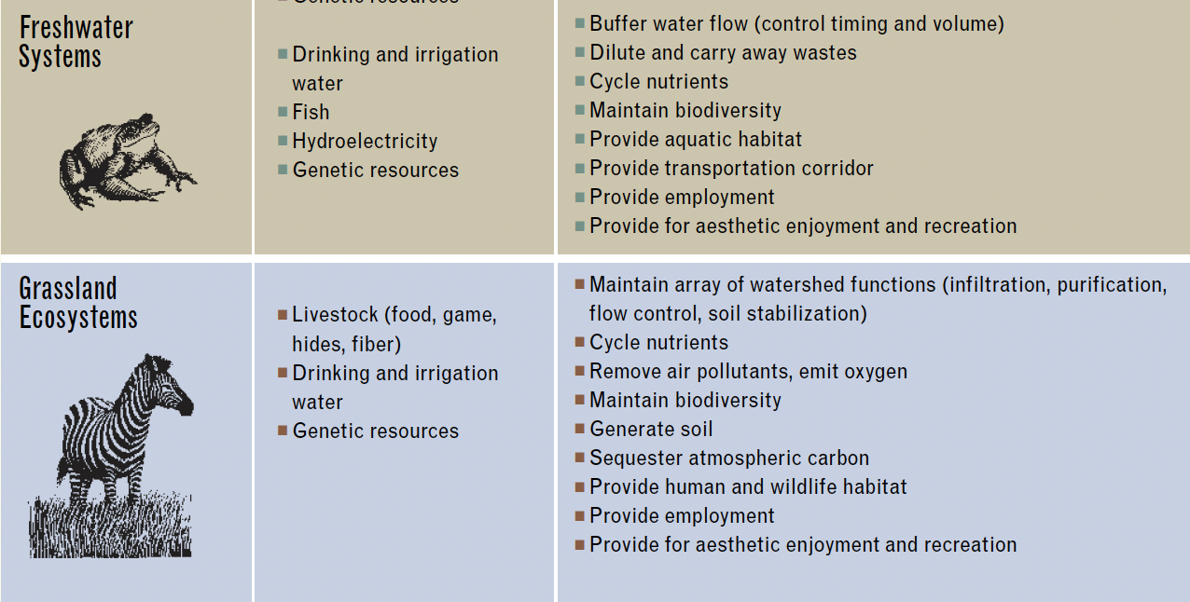

Slide 51
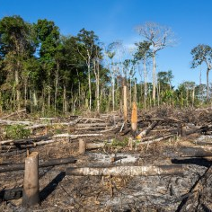
Ecosystem Degradation
75% of major marine fish stocks either depleted from overfishing or are being fished to their biological limit.
Logging and conversion have shrunk the world’s forest cover by as much as half, and roads, farms and residences are rapidly fragmenting what remains into smaller forest islands.
58% of coral reefs are potentially threatened by destructive fishing practices, tourist pressures and pollution
65% of the roughly 1.5 billion ha of cropland worldwide have experienced some degree of soil degradation.
Overpumping of groundwater by the world’s farmers exceeds natural recharge rates by at least 160 billion m3/year

Slide 52
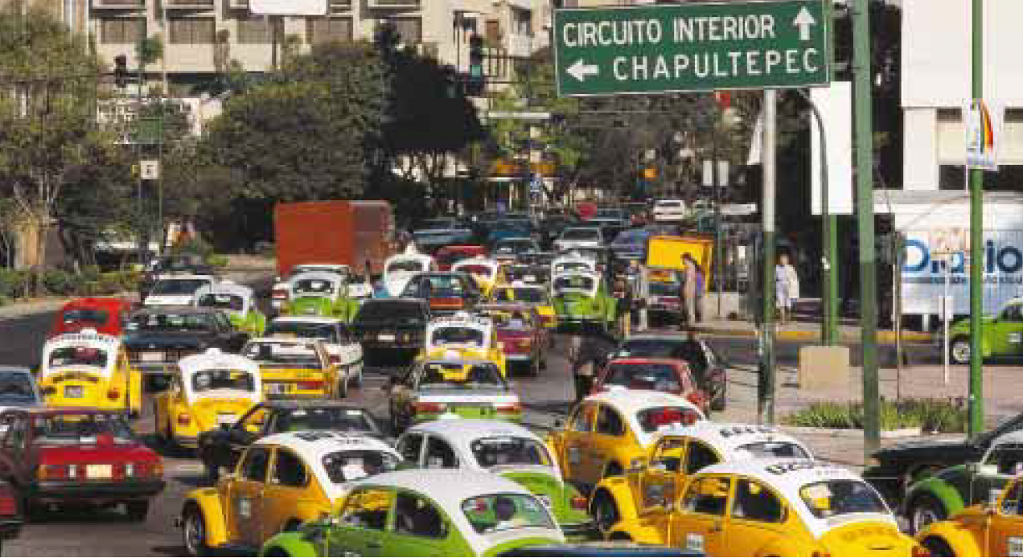
Principle pressures
Overuse
Conversion
Invasive species
Pollution
Climate change

Slide 53
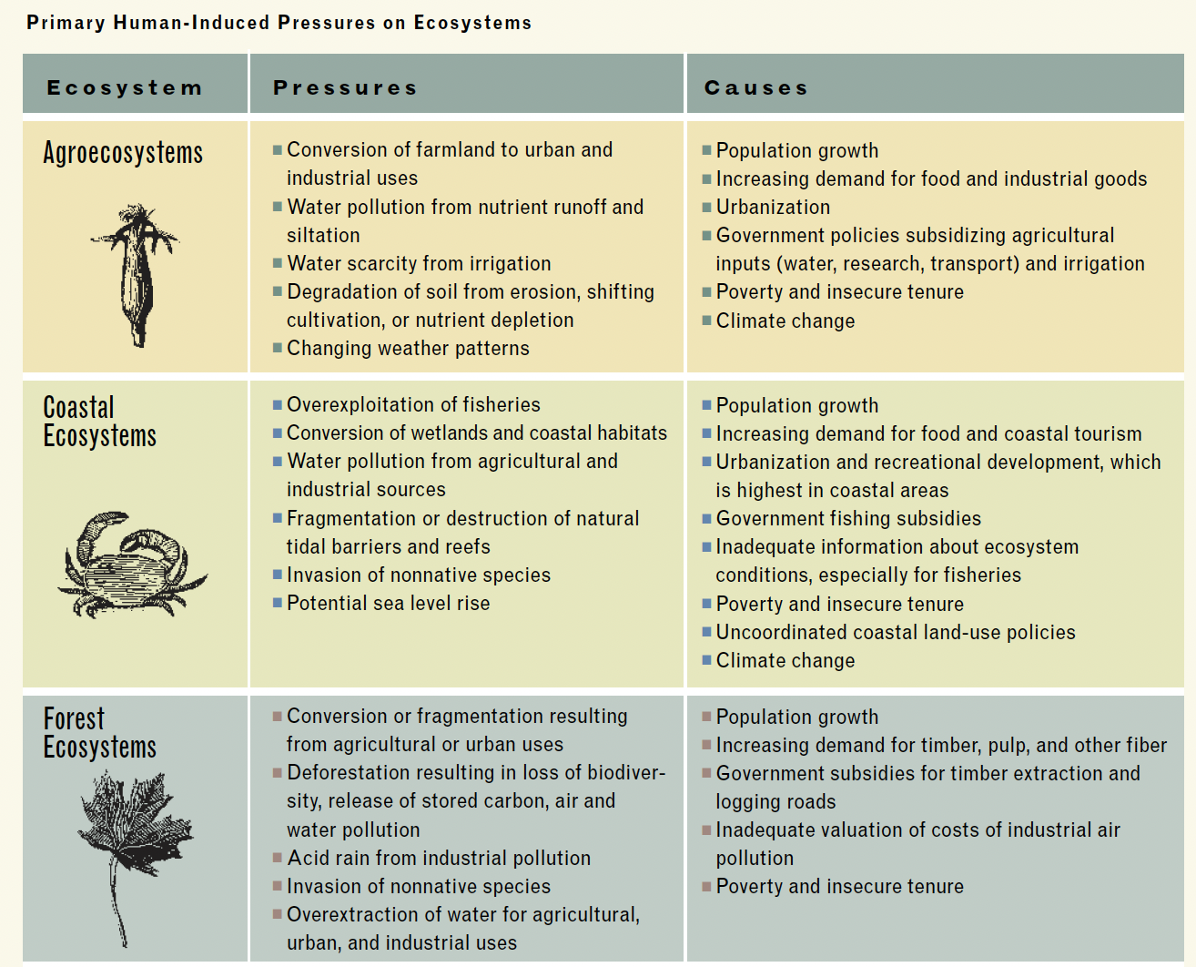

Slide 54
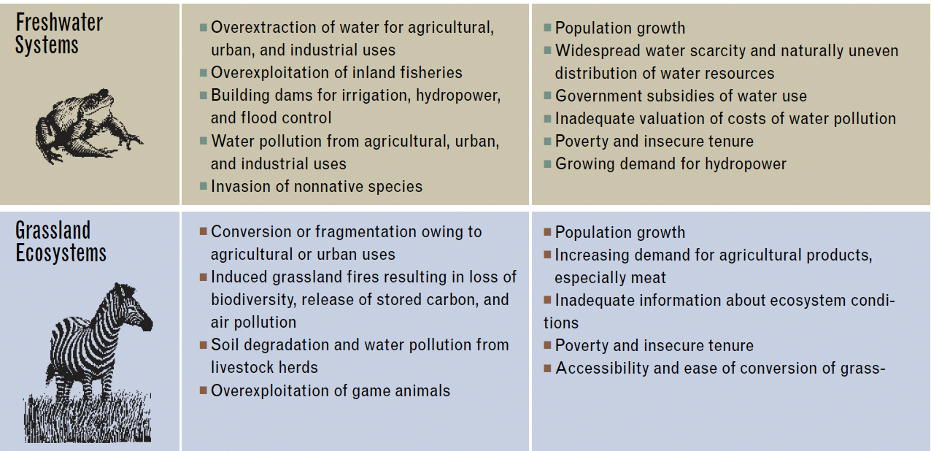

Slide 55
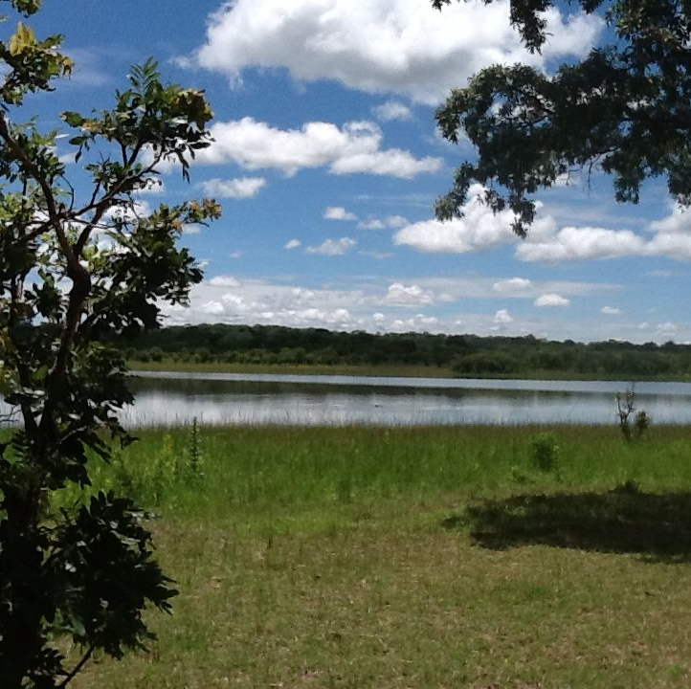
Adopting an Ecosystem Approach
An ecosystem approach broadly evaluates how people’s use of an ecosystem affects its functioning and productivity.
An ecosystem approach is an integrated approach
An ecosystem approach reorients the boundaries that traditional have defined our management of ecosystems
An ecosystem approach takes the long view
An ecosystem approach includes people
An ecosystem approach maintains the productive potential of ecosystems

Slide 56
